Slide 1
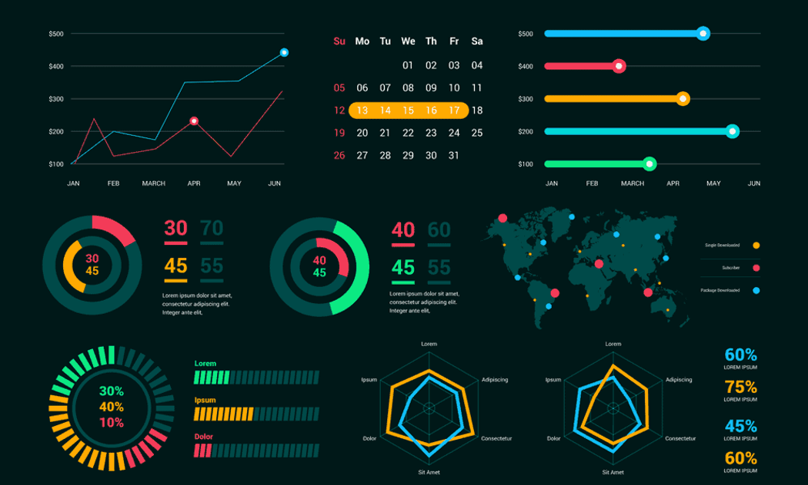
Data Visualization

Slide 2


What is Data Visualisation?

Slide 3

Basic Definition
Data visualization is the graphical representation of information and data.
By using visual elements like charts, graphs, and maps, data visualization tools provide an accessible way to see and understand trends, outliers, and patterns in data.

Slide 4

Applications
Weighing Scale
Car dashboard to represent speed and fuel levels
Watch, represents time
Mile markers on the road to give you distance
Gym machines showing distance and calories
Calendar
Sleep trackers
Step/Activity trackers

Slide 5
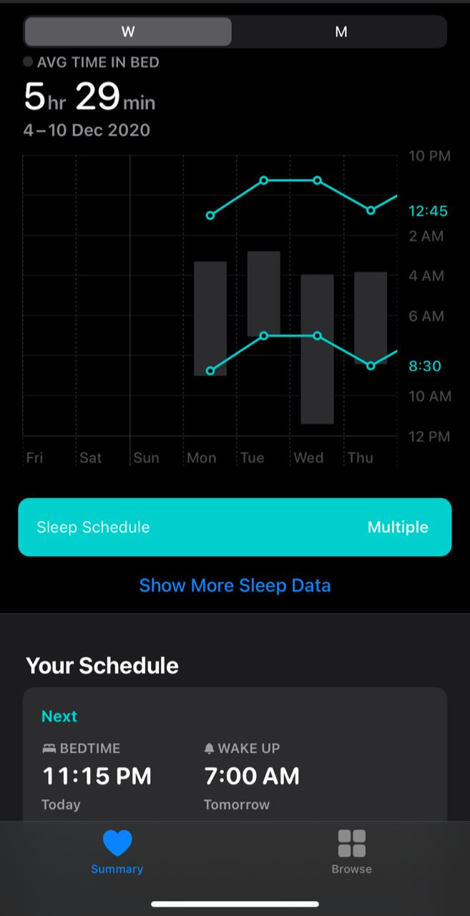

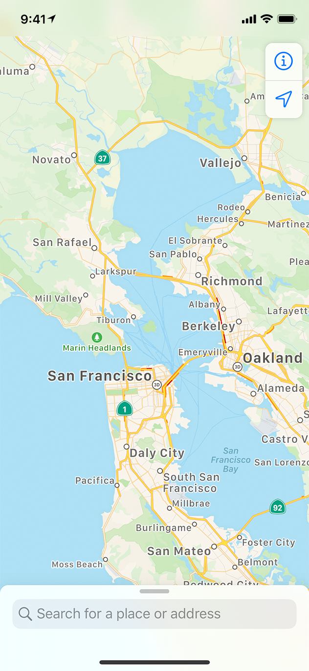
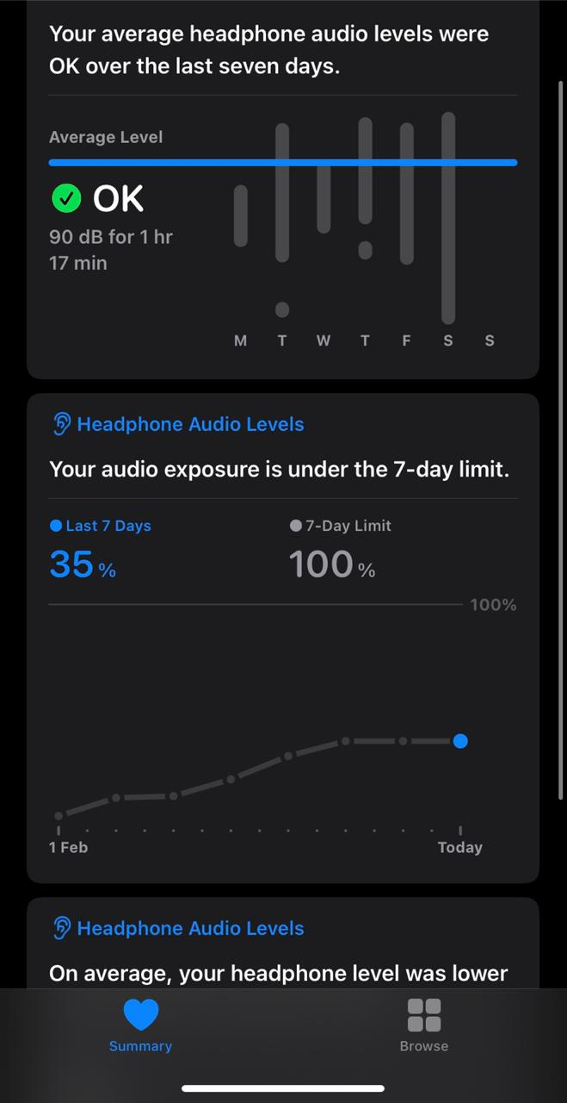
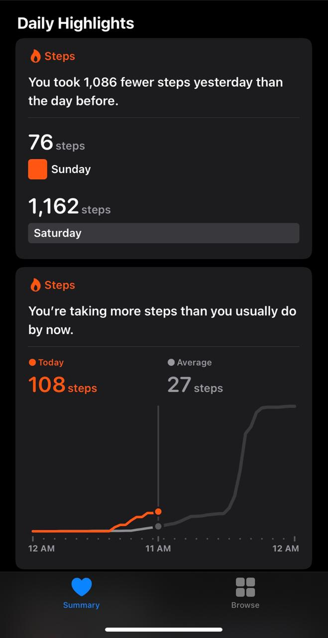
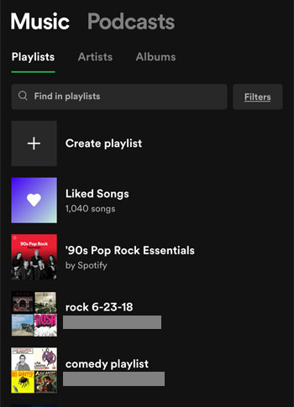


Slide 6
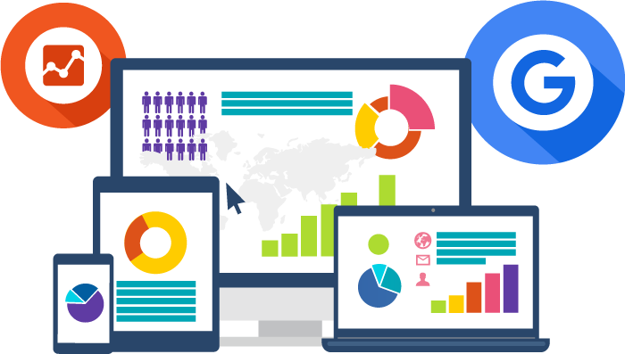
Why is it important?
Data visualization is needed because a visual summary of information makes it easier to identify patterns and trends than looking through thousands of rows on a spreadsheet. It’s the way the human brain works.
Charts and graphs make communicating data findings easier even if you can identify the patterns without them.

Slide 7

Data Visualization Tools
Google Charts
Tableau
Grafana
Chartist.js
FusionCharts
Datawrapper
Infogram
ChartBlocks
D3.js
Jupyter Notebook

Slide 8
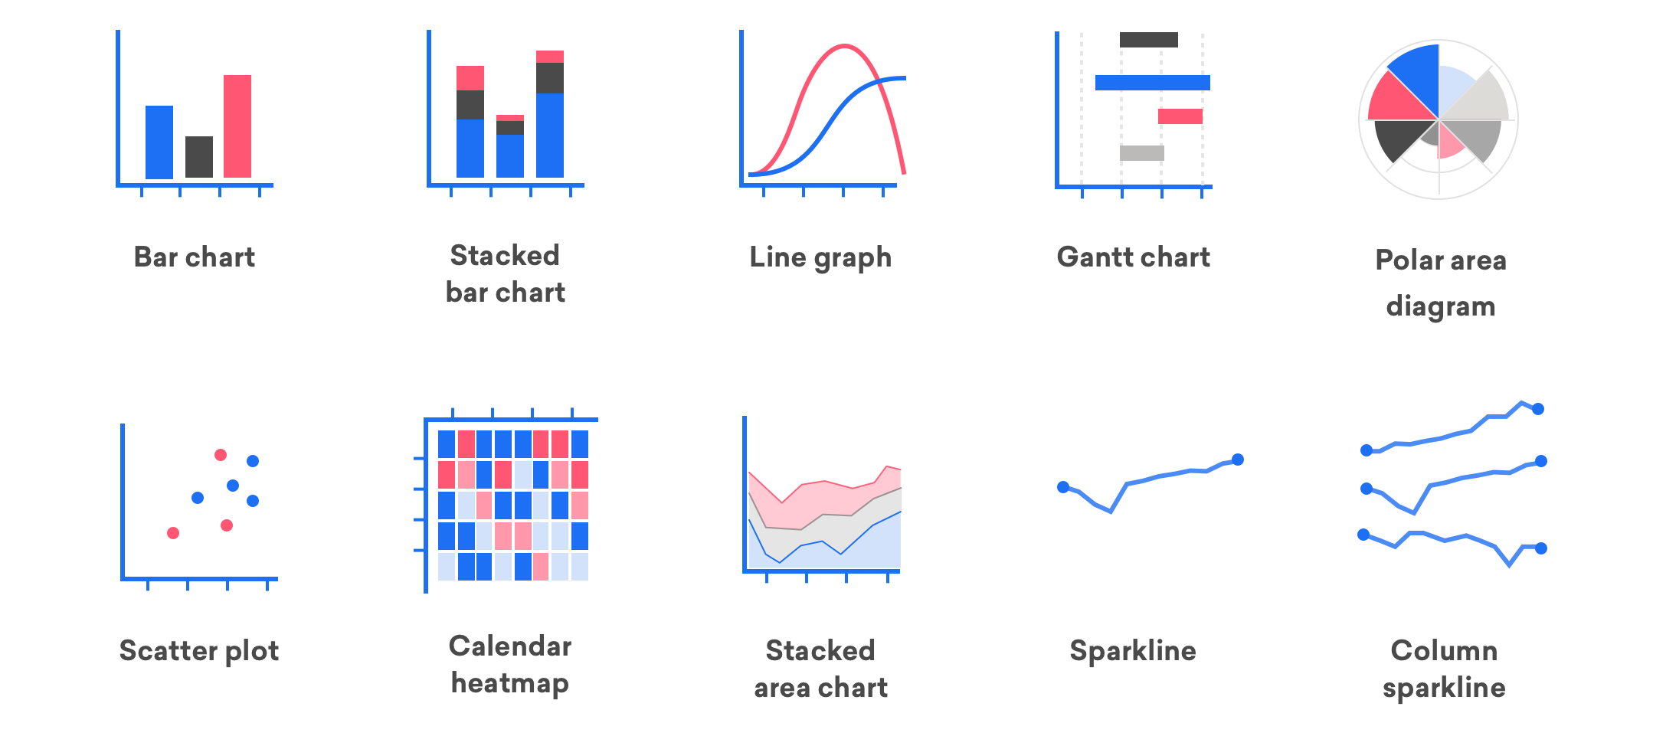
Ways to represent Data

Slide 9
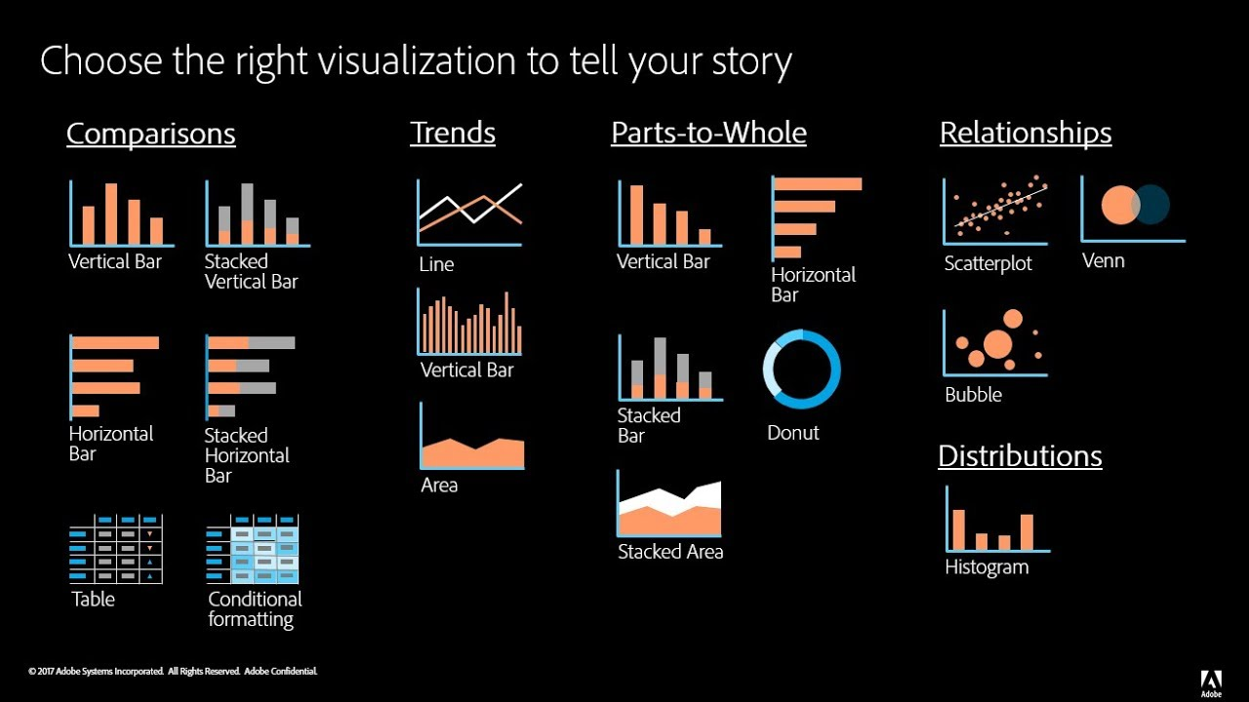

Slide 10

Sources to learn Data Visualization
Data Visualization with Tableau Certification by UCDavis (Coursera)
Data Visualization with Python by IBM (Coursera)
Data Visualization and Communication with Tableau by Duke University (Coursera)
Tableau Training and Certification Courses (Udemy)
Data Visualization with Advanced Excel by PwC (Coursera)
Mastering Data Visualization in D3.js (Udemy)

Slide 11

Future Scope
Data visualization is the obvious answer to turning all of that data into actual usable information that will drive a business forward. Cheaper and more reliable ways to store data than ever before and with it comes the ability for everyone, from the data-savvy to the data-averse, to visualize information that pertains to their specific business needs.
With the unprecedented generation of data, conventional desktop monitors or television screens are likely to be insufficient to represent 2D and even 3D images. It is possible that virtual reality (or VR) will be employed to analyze and review data in a 360-degree virtual space. Business presentations are likely to happen in a VR-simulated environment with business executives seated around viewing at a projector screen.

Slide 12

Thank You

Slide 13





Follow Us:
Facebook:
https://www.facebook.com/ISTE.VIT/
Instagram: @iste_vit_vellore https://instagram.com/iste_vit_vellore?igshid=8cxegsoxbyh0
LinkedIn: https://www.linkedin.com/company/indian-society-for-technical-education
Github: https://github.com/ISTE-VIT

